Slide 1
Fundamentals of Analytical chemistry (221)
CHAPTER-4
Common salts (NaCl, KCl and Na₂CO₃) and the Chlor-Alkali Industry

Slide 2
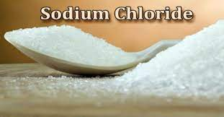
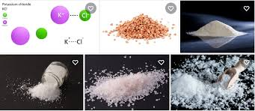
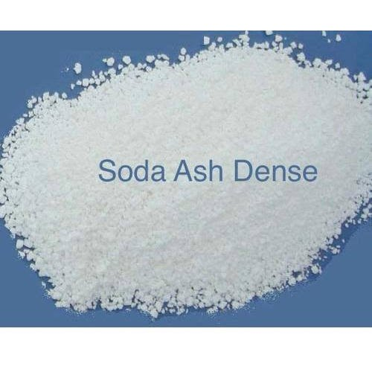
Cont’.....

Slide 3
Cont’.....
4.1 Common salt : its sources and production
Sodium chloride, also known as common salt, table salt, or halite, is a chemical compound with the formula NaCl.
Sodium chloride is the salt most responsible for the salinity of the ocean and of the extracellular fluid of many multicellular organisms.
As the main ingredient in edible salt, it is commonly used as a condiment and food preservative.
Common salt is currently produced by evaporation of seawater or brine from other sources, such as brine wells and salt lakes, and by mining rock salt, called halite.

Slide 4
Cont’.....
Uses of NaCl.
Common salt is also the raw material used to produce chlorine which itself is required for the production of many modern materials including PVC and pesticides.
Industrially, elemental chlorine is usually produced by the electrolysis of sodium chloride dissolved in water.
Along with chlorine, this chloralkali process yields hydrogen gas and sodium hydroxide, according to the chemical equation.
2NaCl + 2H₂O → Cl₂ + H₂ + 2NaOH

Slide 5
Cont’.....
Sodium chloride is used in other chemical processes for the large-scale production of compounds containing sodium or chlorine.
In the Solvay process, sodium chloride is used for producing sodium carbonate and calcium chloride.
Food Uses
Salt is commonly used as a flavor enhancer and preservative for food and has been identified as one of the basic tastes
Biological uses
Many microorganisms cannot live in an overly salty environment: water is drawn out of their cells by osmosis.

Slide 6
Cont’.....
Manufacture of Potassium chloride (KCl)
The chemical compound potassium chloride (KCl) is a metal halide composed of potassium and chlorine
In its pure state it is odorless.
It has a white or colorless vitreous crystal, with a crystal structure that cleaves easily in three directions.
Potassium chloride crystals are either simple cubic or face-centered cubic depending on what atoms are involved.
Potassium chloride is also commonly known s "Muriate of Potash".

Slide 7
Cont’.....
Potash varies in color from pink or red to white depending on the mining and recovery process used.
White potash, sometimes referred to as soluble potash, is usually higher in analysis and is used primarily for making liquid starter fertilizers.
Potassium chloride occurs naturally as the mineral sylvite and in combination with sodium chloride as sylvinite and it can be extracted from sylvinite.
It is also extracted from salt water and can be manufactured by crystallization from solution, flotation or electrostatic separation from suitable minerals.

Slide 8
Cont’.....
It is a by-product of the making of nitric acid from potassium nitrate and hydrochloric acid.
Chemical properties of KCl
As with any other soluble ionic chloride, it will precipitate insoluble chloride salts when added to a solution of an appropriate metal ion:
KCl(aq) + AgNO₃(aq) → AgCl(s) + KNO₃(aq)
Although potassium is more electropositive than sodium, KCl can be reduced to the metal by reaction with metallic sodium at 850°C because the potassium is removed by distillation
KCl(l) + Na(l) ⇌ NaCl(l) + K(s)

Slide 9
Cont’.....
This method is the main method for producing metallic potassium.
Uses of KCl
The majority of the potassium chloride produced is used for making fertilizer, since the growth of many plants is limited by their potassium intake.
As a chemical feedstock it is used for the manufacture of potassium hydroxide and potassium metal.
It is also used in medicine, scientific applications, food processing, as a sodium-free substitute for table salt, and in judicial execution through lethal injection.

Slide 10
Cont’.....
Biological/Medical uses
Potassium is vital in the human body and oral potassium chloride is the common means to replenish it, although it can also be diluted and given intravenously
It can be used as a salt substitute for food, but due to its weak, bitter, unsalty flavor, it is usually mixed with regular salt, sodium chloride, for this purpose to improve the taste.
Medically it is used in the treatment of hypokalemia and associated conditions, for digitalis poisoning, and as an electrolyte replenisher.

Slide 11
Cont’.....
Manufacture of Sodium carbonate ( Na₂CO₃)
Sodium carbonate, which is also known as soda ash or washing soda, is written as Na₂CO₃ in molecular formula.
It has high solubility in water and is a salt-based compound.
Due to its great economic value in the manufacturing industry, a great number of chemists have been researching ways of producing sodium carbonate since the 1800s.
The most common technique for producing sodium carbonate is known as the Solvay's process

Slide 12
Cont’.....
Synthetically forms of this salt are used in glass, water softeners, electrolytes, and components of ramen.
Manufacture of Na₂CO₃ using Leblanc process
Leblanc process (1810):- Based on the synthesis of H₂SO₄
2NaCl + H₂SO₄ → Na₂SO₄ + 2HCl
Na₂SO₄ + CaCO₃ + 2C → Na₂CO₃ + CaS + 2CO₂
NaOH was prepared from the sodium carbonate:
Na₂CO₃ + Ca(OH)₂ → 2NaOH + CaCO₃
Solvay process was introduced in 1874 by Ernst Solvay Belgium Chemist (1838-1922)

Slide 13
Cont’.....
Advantages of Solvay were:-
less waste (low volume CaCl₂ vs high vol CaSO₄),
use of brine,
CO₂/NH₃ recovered,
costs some 70% less.
However, plant cost was greater
1890 Solvay was 90% of market

Slide 14
Cont’.....
The Solvay process is a major industrial process that has been widely used for production of soda ash from the materials, brine as a source of sodium chloride (NaCl), ammonia which is made by Haber's Process and limestone as a source of Calcium Carbonate (CaCO₃).
This process is significant because it uses low priced and plentiful raw materials to make useful chemicals.
The Solvay process revolves around a large hollow tower and contains the following steps:

Slide 15
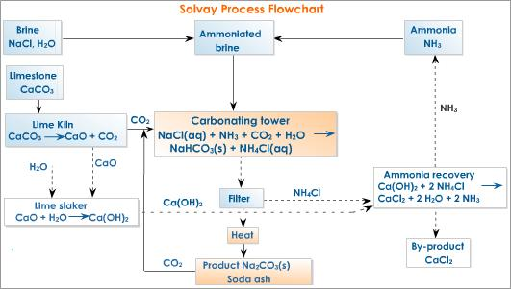
Cont’.....
Schematic diagram of the manufacturing processes of Na₂CO₃ (Solvay process)

Slide 16
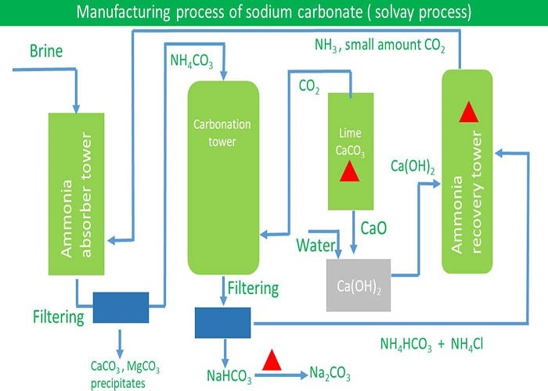
Cont’.....

Slide 17
Cont’.....
1)Purification of Brine
Brine is pumped into shallow ponds where water is evaporated by the sun leaving salt which contains a mixture of calcium, magnesium and sodium chloride salts.
These impurities are removed by precipitation.
2) Ammonization of Brine
In this process, ammonia gas is mixed with brine and is carried out in the Ammonization Tower.
The Solvay Tower contains mushroom shaped baffles to control the flow of brine to ensure proper mixing and to dissolve ammonia.

Slide 18
Cont’.....
3) Carbonation of Ammoniated Brine
In this step ammoniated brine is mixed with carbon dioxide which is produced by heating limestone in a separate chamber called "kiln.“
Kiln-an oven, furnace, or heated enclosure used for processing a substance by burning, firing, or drying.
4) Sodium hydrogen Carbonate Formation
Carbon dioxide is then dissolved in the brine solution and ammonia is dissolved in the purified brine (NaCl)
NH₃(aq) + CO₂(g) + NaCl(aq) + H₂O(l) → NaHCO₃(s) + NH₄Cl(aq)

Slide 19
Cont’.....
The sodium hydrogen carbonate is removed from the carbonating tower heated by calcination at 30⁰C so that it decomposes to sodium carbonate, water and carbon dioxide:
2NaHCO₃ (s)--> Na₂CO₃ (s) + H₂O(g) + CO₂ (g)
Sodium carbonate is obtained from the process and carbon dioxide is recycled back into the Carbonation tower.
5) Ammonia Recovery
In this process, CaO from the first step reacts with water to form calcium hydroxide.
CaO(s) + H₂O(l) →Ca(OH)₂(aq)

Slide 20
Cont’.....
Calcium hydroxide produced is reacted with ammonium chloride that was separated out of the carbonating tower by filtration: Ca(OH)₂(aq) + 2NH₄Cl(aq) → CaCl(aq) + 2H₂O(l) + 2NH₃(g)
The ammonia is then recycled back into the process to form ammoniated brine and calcium chloride is formed as a by product (waste) of the Solvay Process.

Slide 21
Cont’.....
Manufacture of Na₂CO₃ from Trona
Throughout the rest of the world, however, the Solvay process remains the major source of soda ash.
Trona is found in the form of Na₂CO₃.NaHCO₃.2H₂O
For example: In our country Abijata, Soda ash plant manufacture Soda ash(powder of Na₂CO₃) from trona that is found naturally from Abijata lake.
The water of the lake is composed of of Na₂CO₃, .NaHCO₃, NaCl and NaF.
Using different ponds, trona is obtained and went to the factory to get the purified form of Na₂CO₃.

Slide 22
Cont’.....
Uses of Na₂CO₃
Sodium carbonate is one of the compounds that are most frequently used in many fields of today's manufacturing industry.
It’s most significant use can be found when making transparent non-crystalline material, which is glass.
It can be used for water treatment (e.g; removal of permanent hardness)
It is also used widely as an electrolyte by many chemists when electrolysis is performed, because the salt has high solubility in water and high conductivity
For housekeepers, as well as chemists, the presence of sodium carbonate is important because most water softeners use sodium carbonate every day.

Slide 23
Cont’.....
Chlor-Alkali Industries (Cl₂ and NaOH)
Nature of these chemicals
The manufacture of chlorine and caustic soda are one of the most important heavy chemical industries.
These chemicals rank next to sulfuric acid and ammonia in magnitude of dollar value of use.
Chlorine and caustic soda are produced almost entirely by electrolytic methods from fused chlorides or aqueous solutions of alkali metal chlorides.
In the electrolysis of brines, chlorine is produced at the anode, and hydrogen, together with sodium or potassium hydroxide, at the cathode.

Slide 24
Cont’.....
Chlorine
Is a strong bleaching agent and disinfectant used in textiles and medical application
Cell technologies
NaCl + H₂O → NaOH + ½H₂ + ½Cl₂
Regardless of cell type, the evolution of chlorine takes place at the anode of the cell:
Based on cell type, hydrogen and the hydroxide ions to form sodium hydroxide are generated, directly or indirectly, at the cathode of the cell:
Notable characteristics

Slide 25
Cont’.....
Chlorine gas in a plastic container.
It is not advisable to store chlorine in this manner
Chlorine gas is diatomic, with the formula Cl₂.
It combines readily with nearly all other elements, although it is not as extremely reactive as fluorine.
History of Chlorine
Chlorine was discovered in 1774 by Swedish chemist Carl Wilhelm Scheele
Chlorine was given its current name in 1810 by Sir Humphry Davy, who insisted that it was in fact an element.

Slide 26
Cont’.....
Occurrence
In nature, chlorine is found primarily as the chloride ion, a component of the salt that is deposited in the earth or dissolved in the oceans
Chlorine gas extraction
Chlorine can be manufactured by electrolysis of a sodium chloride solution (brine).
The production of chlorine results in the co-products caustic soda(NaOH) and hydrogen gas (H₂).
Chlorine can also be produced by the electrolysis of a solution of potassium chloride, in which case the co-products are hydrogen and caustic potash (potassium hydroxide)

Slide 27
Cont’.....
There are three industrial methods for the extraction of chlorine by electrolysis of chloride solutions, all proceeding according to the following equations:
Cathode: 2 H⁺ (aq) + 2 e⁻ → H₂ (g)
Anode: 2 Cl⁻ (aq) → Cl₂ (g) + 2 e⁻
Overall process: 2 NaCl (or KCl) + 2 H₂O → Cl₂ + H₂ + 2 NaOH (or KOH)
Other electrolytic processes
Production of Chlorine using Deacon Process:
Before electrolytic methods were used for chlorine production, the direct oxidation of hydrogen chloride with oxygen or air was exercised in the Deacon process:
4 HCl + O₂ → 2 Cl₂ + 2 H₂O

Slide 28
Cont’.....
This reaction is accomplished with the use of CuCl₂ as a catalyst and is performed at high temperature (about 400°C).
The amount of extracted chlorine is approximately 80%.
Another earlier process to produce chlorine was to heat brine with acid and manganese dioxide.
2 NaCl + 2H₂SO₄ + MnO₂ → Na₂SO₄ + MnSO₄ + 2 H₂O + Cl₂
Industrial production of Cl_{2.}
Large-scale production of chlorine involves several steps and many pieces of equipment.

Slide 29
Cont’.....
The description below is typical of a membrane plant. The plant also produces simultaneously caustic soda and hydrogen gas.
A typical plant consists of:
brine production/treatment,
cell operations,
chlorine cooling & drying,
chlorine compression & liquefaction,
liquid chlorine storage & loading,
caustic handling,
evaporation, storage & loading and hydrogen handling.

Slide 30
Cont’.....
Applications and uses of Cl_{2.}
Production of industrial and consumer products
Chlorine's principal applications are in the production of a wide range of industrial and consumer products.
For example, it is used in making plastics, solvents for dry cleaning and metal degreasing, textiles, agrochemicals and pharmaceuticals, insecticides, dyestuffs, etc.
Purification and disinfection
Chlorine is an important chemical for water purification, in disinfectants, and in bleach.

Slide 31
Cont’.....
It is used (in the form of hypochlorous acid) to kill bacteria and other microbes in drinking water supplies and public swimming pools.
However, in most private swimming pools chlorine itself is not used, but rather sodium hypochlorite (household bleach), formed from chlorine and sodium hydroxide, or solid tablets of chlorinated isocyanurates.
Chlorine is used in the manufacture of numerous organic chlorine compounds, the most significant of which in terms of production volume are 1,2-dichloroethane and vinyl chloride, intermediates in the production of PVC.
Chlorine is also used in the production of chlorates and in bromine extraction.

Slide 32
Cont’.....
Safety while handling Cl₂
Chlorine is a toxic gas that irritates the respiratory system.
Because it is heavier than air, it tends to accumulate at the bottom of poorly ventilated spaces.
Chlorine gas is a strong oxidizer, which may react with flammable materials.

Slide 33
Cont’.....
Sodium hydroxide (NaOH)
Sodium hydroxide (NaOH), also known as lye, caustic soda and sodium hydrate, is a caustic metallic base.
Caustic soda forms a strong alkaline solution when dissolved in a solvent such as water.
It is used in many industries, mostly as a strong chemical base in the manufacture of pulp and paper, textiles, drinking water, soaps and detergents and as a drain cleaner.
Sodium hydroxide is the most used base in chemical laboratories.

Slide 34
Cont’.....
Pure sodium hydroxide is a white solid; available in pellets, flakes, granules and as a 50% saturated solution.
It is very soluble in water with liberation of heat.
It also dissolves in ethanol and methanol, though it exhibits lower solubility in these solvents than potassium hydroxide.
It is insoluble in ether and other non-polar solvents.
A sodium hydroxide solution will leave a yellow stain on fabric and paper.
Chemical properties of NaOH.
Sodium hydroxide is completely ionic, containing sodium ions and hydroxide ions.

Slide 35
Cont’.....
The hydroxide ion makes sodium hydroxide a strong base which reacts with acids to form water and the corresponding salts, e.g., with hydrochloric acid, sodium chloride is formed:
NaOH(aq) + HCl(aq) → NaCl(aq) + H₂O(l)
In general such neutralization reactions are represented by one simple net ionic equation:
OH⁻(aq) + H₃O⁺(aq) → 2H₂O
This type of reaction with a strong acid, releases heat, and hence is referred to as exothermic.

Slide 36
Cont’.....
Sodium hydroxide slowly reacts with glass to form sodium silicate, so glass joints and stopcocks exposed to NaOH have a tendency to "freeze
Aluminum hydroxide is prepared at the treatment plant from aluminium sulfate by reacting with NaOH:
6NaOH(aq) + Al₂(SO₄)₃(aq) → 2Al(OH)₃(s) + 3Na₂SO₄(aq)
NaOH can be used for the base-driven hydrolysis of esters (as in saponification), amides and alkyl halides.
However, the limited solubility of NaOH in organic solvents means that the more soluble KOH is often preferred.

Slide 37
Cont’.....
Methods of production
There are two major types of production of Sodium hydroxide.
These are Classical method and electrolysis methods.
i) Production of NaOH using Classical method
The main raw materials in the production of NaOH using classical method are CaCO₃ and Na₂CO₃
Reaction: CaCO₃(s) + heat → CaO + CO₂ (g)
CaO(s) + H₂O(l) → Ca(OH)₂(aq)
Ca(OH)₂(aq) + Na₂CO₃ → 2NaOH(aq) + CaCO₃(s)
Product by-product

Slide 38
Cont’.....
For example in our country, Ziway Caustic soda plant manufactures caustic soda (NaOH) by using the classical method
In the factory a concentration of 45-55% NaOH is produced, which is in the aqueous solution form.
Production of NaOH using electrolysis method.
Sodium hydroxide is produced (along with chlorine and hydrogen) via the chloralkali process.
This involves the electrolysis of an aqueous solution of sodium chloride.
The sodium hydroxide builds up at the cathode, where water is reduced to hydrogen gas and hydroxide ion

Slide 39
Cont’.....
2Na⁺ + 2H₂O + 2e⁻ → H₂ + 2NaOH
Uses of NaOH
General applications
Sodium hydroxide is the principal strong base used in the chemical industry.
In bulk it is most often handled as an aqueous solution, since solutions are cheaper and easier to handle.
It is used to drive chemical reactions and also for the neutralization of acidic materials.
It can be used also as a neutralizing agent in petroleum refining.

Slide 40
Cont’.....
Use in chemical analysis
In analytical chemistry, sodium hydroxide solutions are often used to measure the concentration of acids by titration.
Since NaOH is not a primary standard, solutions must first be standardized by titration against a standard such as sodium carbonate solution.
Soap production
Sodium hydroxide was traditionally used in soap making(Saponification process)
Biodiesel
For the manufacture of biodiesel, sodium hydroxide is used as a catalyst for the trans esterification of methanol and triglycerides.

Slide 41
Cont’.....
Food preparation
Food uses of lye include washing or chemical peeling of fruits and vegetables, chocolate and cocoa processing, caramel color production, poultry scalding, soft drink processing, and thickening ice cream.
Domestic uses
Sodium hydroxide is used in the home as a drain cleaning agent for clearing clogged drains
For example very dilute solutions of NaOH( about 2-3% of NaOH) is used for cleaning of bottles in Brewery

Slide 42
Cont’.....
Safety
Solid sodium hydroxide or solutions containing high concentrations of sodium hydroxide may cause chemical burns, permanent injury or scarring, and blindness.
Dissolution of sodium hydroxide is highly exothermic, and the resulting heat may cause heat burns or ignite flammables.
The combination of aluminum and sodium hydroxide results in a large production of hydrogen gas:
2Al(s) + 6NaOH(aq) → 3H₂(g) + 2Na₃AlO₃(aq)
Mixing these two in a closed container is therefore dangerous.
Can be used as in the process of Illegal drugs
Sodium hydroxide is a key reagent in the process of making Methamphetamine and other illegal drugs.

Slide 43
Chapter 5. Industrial derivatives of nitrogen
5.1. Cyanamide Process and Haber Process of Ammonia synthesis (Group-1)
5.2. Manufacture of Nitric acid and its uses (Group-2)
5.3. Manufacture of TNT, Nitrocellulose and Nitroglycerine
(Group-3)
Group Assignment ( document submission and presentation)
Remark: This is only for the Frist group (section-1)

Slide 44
Chapter 6. Fertilizers and Phosphoric acids
6.1. Chemistry of manufacture of phosphoric acid(Group-1)
6.2. Phosphoric acid series(Group-2)
6.3. Essential and trace elements for plant growth(Group-3)
6.4. Manufacture of nitrogenous fertilizers – calcium cyanamide, ammonium Nitrate & urea(Group-4)
6.5. Potash Fertilizers(Group-5)
6.6. Manufacture of super phosphate and triple super phosphate fertilizers(Group-4 for section one students)
Group Assignment( document submission and presentation)

